Slide 1
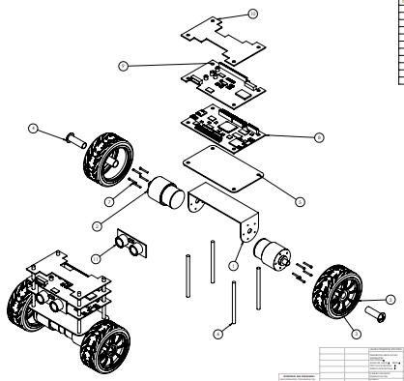
Robogames
Fahad alostath
Naif alfihan
Sponsor: Program FEES

Slide 2
Introduction
The is a Design project to make a robot which provides a sufficient way to Balancing Robot
An Autonomous Robot with the Wheels to balance on rough and tough terrains
With the help of wheels, it can move in all the directions on different terrains to show the balancing.
Control the Robot through the instructions uploaded in its system
Project Sponsored by: PROGRAM FEES
Fahad Alostath

Slide 3
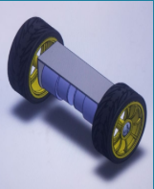
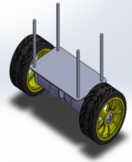
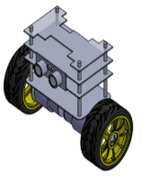
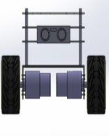
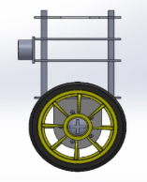
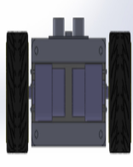
Design Description
3D CAD MODEL BREAKDOWN STRUCTURE
Naif Alfihan

Slide 4
Design Description
Components
Batteries
Wheels
Arduino
Pins
DC-Motor
Top Glass
Tray
Brackets
Gyroscope , Accelerometer
Naif Alfihan

Slide 5
Functioning
Batteries will provide the power to Arduino and other components.
1
Arduino will control the complete robot and will send the instructions to each part
2
Motors will rotate the wheels and move the robot forward and backward
3
Brackets will hold the structure of robot
4
Gyroscope will sense the balancing of robot and will balance robot
5
Naif Alfihan

Slide 6
Current State of System
Currently the components have purchased from Amazon.
Items | Unit Price | Quantity | Total Cost
Motors | $13.99 | 4 | $55.96
Battery Covers | $5.99 | 4 | $23.96
Batteries | $14.50 | 4 | $58.00
Gyroscope | $5 | 2 | $10.00
Arduino Kit | $30 | 1 | $30.00
 | Total Cost |  | $177.92
Naif Alfihan

Slide 7
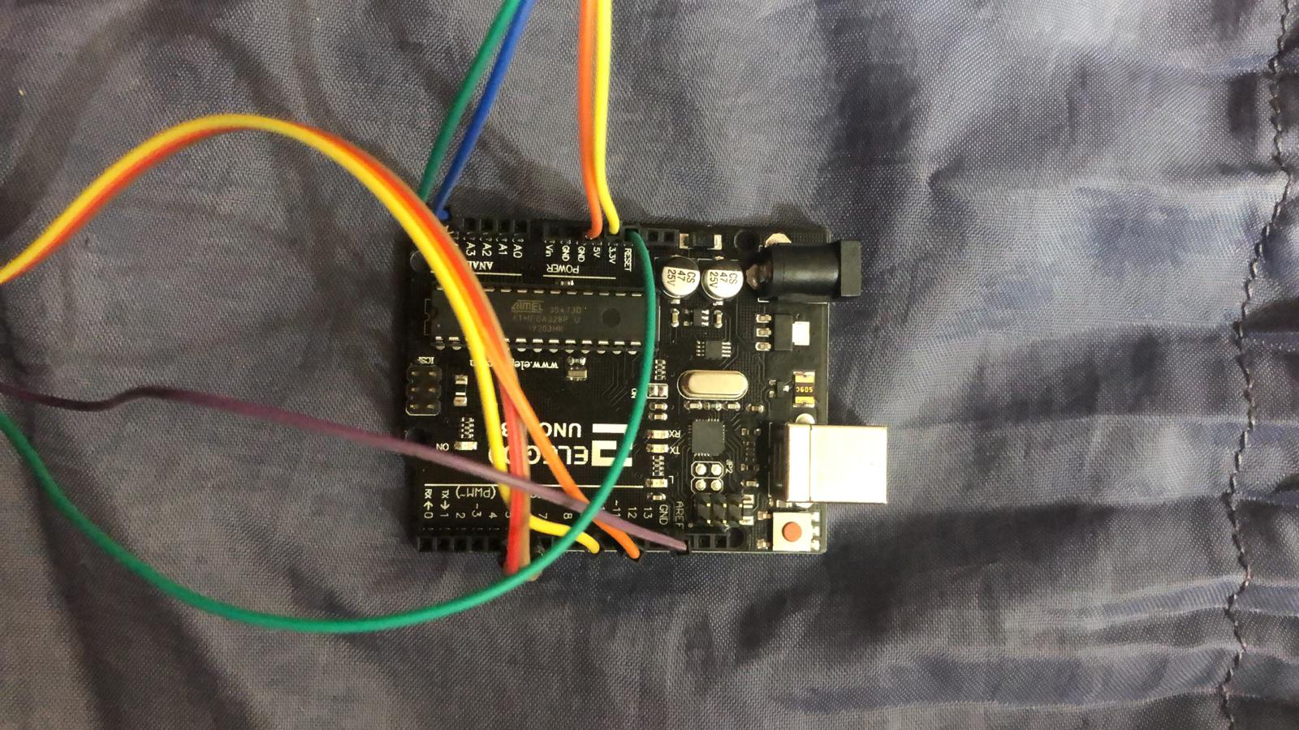

Current State of System
Arduino and Sensor Connections
Fahad Alostath

Slide 8
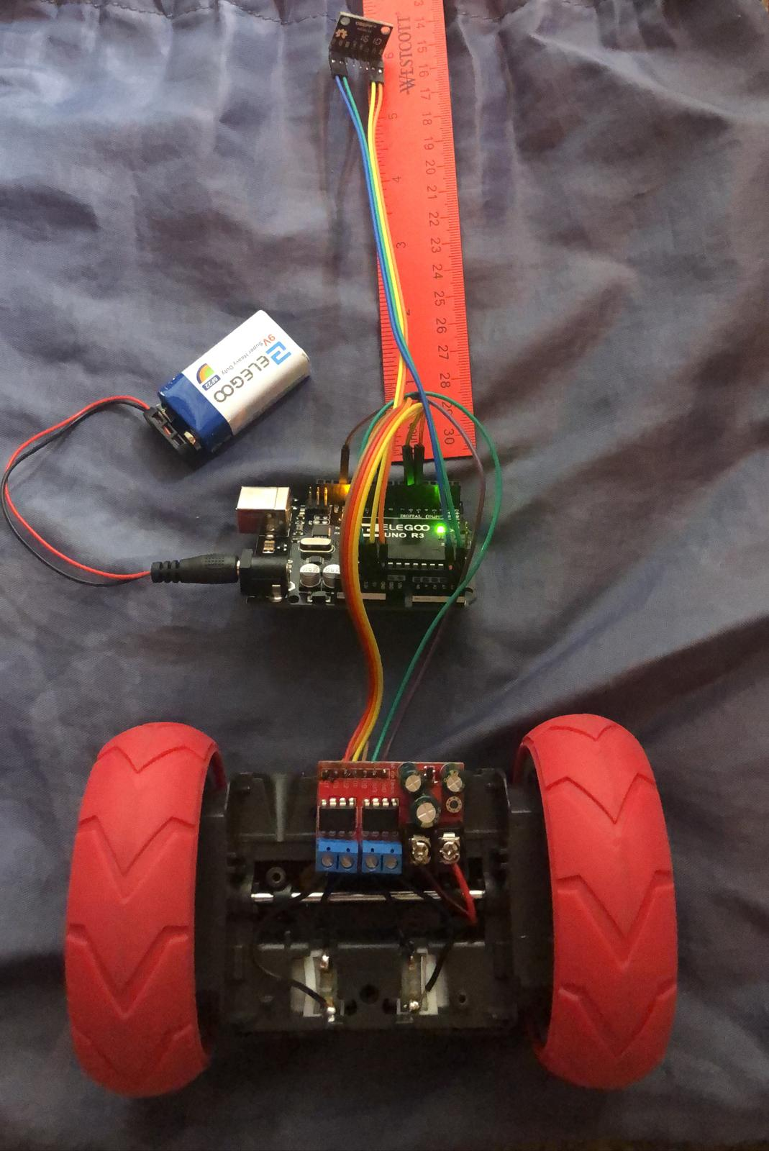
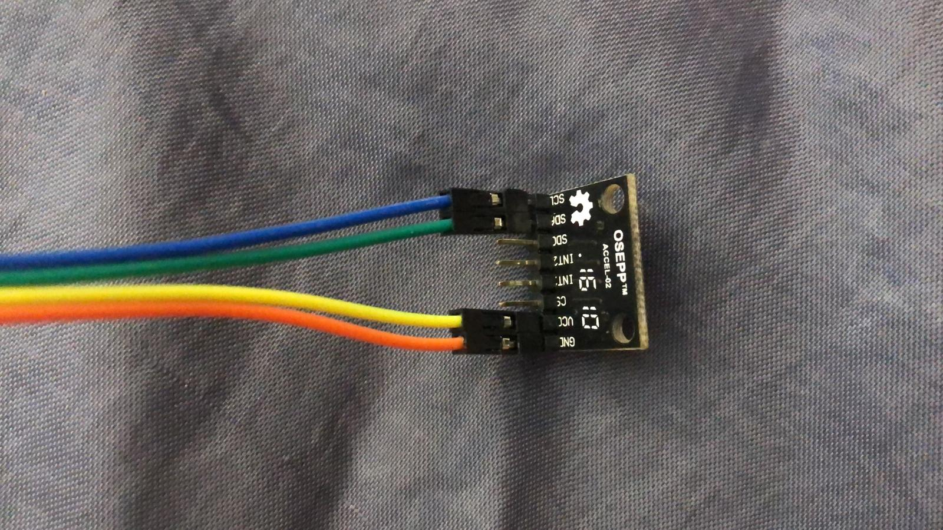
Current State of Syetem
Accelerometer
Basement
Fahad Alostath

Slide 9
Current State of System
We have purchased most of the components
All the components have connected for running and testing
All the tasks have performed together
Fahad Alostath

Slide 10
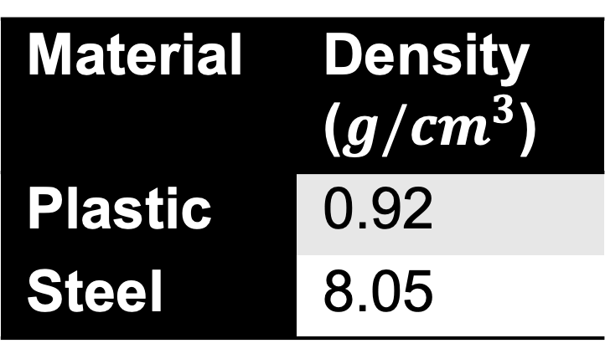
Manufacturing Plan
All the components have connected and working
Need to develop the Robot structure using the plastic
Reason for selecting plastic
Steel has high density
Plastic has low density
Material | Density ($g/cm^{3}$)
Plastic | 0.92
Steel | 8.05
Fahad Alostath

Slide 11
Manufacturing Plan
All the connections have made perfectly for the components
Sensors and Arduino are working using the motor and batteries
Final Product will develop using the Plastic
Future plan to implement the body of robot
Then arrange all the components on the robot body to get the final product.
Fahad Alostath

Slide 12
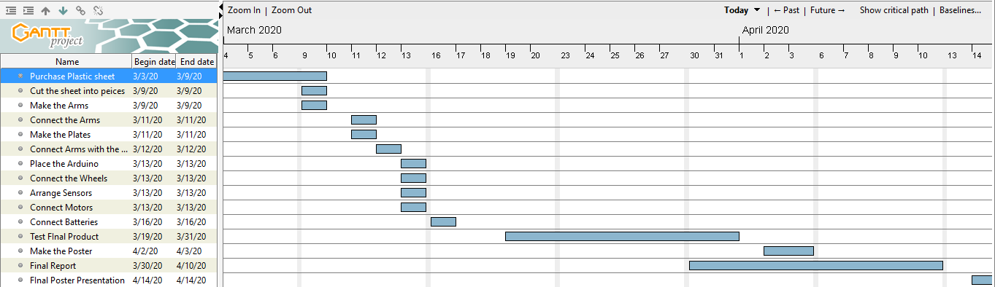
Manufacturing Plan
Fahad Alostath

Slide 13
Testing Plans
Robot will test in an open ground
It will run on rough terrains to see the balancing
It will run for long time to see the battery timing
It will run in a large area to see the distance travel by robot
Naif Alfihan

Slide 14
Testing Procedures
The resources required for the testing to check ER’s are:
Measuring scale (inch and cm units)
Measuring scale (meters)
Sensitive weight machine (lb.)
Stop watch (minutes and seconds)
These resources are available in the mechanical and electrical labs easily.
Naif Alfihan

Slide 15
Testing Procedures
The team need to build the complete robot first
Then these tests will perform.
These tests will perform in the middle of March or first week of April
It will not take much time to perform these tests
It will take 2 to 3 hours to complete these tests.
Naif Alfihan

Slide 16
Reference
[1] https://www.ebay.com/itm/360-20KG-Waterproof-High-Torque-Metal-Gear-RC-Servo-Motor-Car-Helicopter-Boat/
[2] https://www.ebay.com/itm/STAINLESS-STEEL-SHEET-PLATE-in-Various-sizes-and-Thickness/112740090156?var=413195179173&hash=item1a3fd5412c:m:mPUwwyOw159DWFCKTJz7fqA
[3] https://www.ebay.com/itm/Arduino-UNO-R3-Mini-Micro-USB-ATmega328P-CH340G-Replace-ATmega16U2-Board/20192795
[4] https://www.ebay.com/itm/PS4-DUALSHOCK-4-Wireless-Controller-Bluetooth4-0-Gamepad-for-SONY-PlayStation-US/123895207849?hash=item1cd8bad7a9:m:mL4D1NtKRZ7718d31_Ts2fg
[5] https://www.sparkfun.com/products/12577
[6] https://www.ebay.com/itm/Strong-Heavy-Duty-Strap-Hinges-Zinc-Tee-Door-Gate-GOLD-Choose-your-pack-size/142432290165?hash=item2129a04575:m:mRej1rysKMpJj9NQ2h7a8MA
[7] https://www.ebay.com/itm/Multicolor-Adhesive-High-Gloss-Film-Vinyl-PVC-Tape-Automotive-Grade-Car-Wrap/223034541877?var=521843692188&hash=item33ede50735:g:6qEAAOSwi5dcl0Qt
[8] https://www.ebay.com/itm/M3-Black-12-9-Grade-Alloy-Steel-Allen-Hex-Socket-Cap-Head-Screw-Bolt-DIN912/182022519670?_trkpar
[9] https://www.ebay.com/itm/4-4Ah-4400mah-36v-18650-lithium-battery-pack-for-Balance-Scooter-Board-2-wheel/123902060267?_trkparms=aid%3D555018%26algo%3DPL.SIM%26ao%3D1%26asc%3D6
[10] https://www.ebay.com/itm/Safest-3-7V-18650-Charger-Lithium-Ion-Battery-USB-Rechargeable-Battery- Universal/153613634183?_trkparms=ispr%3D1&hash=item23c4160a87:m:m_p07jw_b4GxCYAdeRoJrZQ&enc=AQAEAAA
[11] https://www.ebay.com/itm/10-20-30CM-Jumper-Wire-Cable-Male-to-Male-to-Female-to-Female-Arduino-Breadboard/392315907400?_
[12] https://www.ebay.com/itm/AC110-220V-Power-Supply-Adapter-Transformer-LED-Strip-2A-3A-5A-8A-DC-5V-12V-24V/322286626497?_trkparms=ispr%3D1&hash=item4b09c7a6c1:m:mQ3El- m3_vZFy4IcfeV7aTg&enc=AQAEAAACMBPx

Slide 17
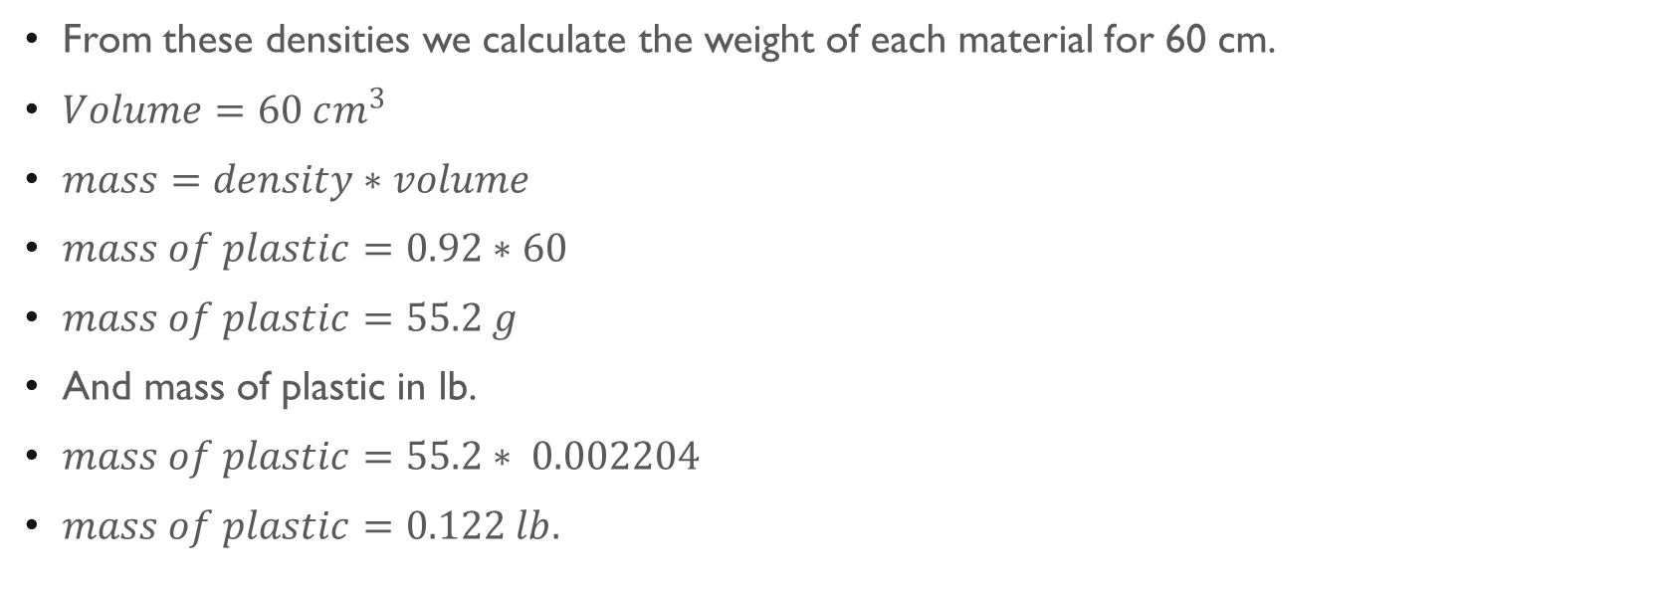
APPENDIX A – DENSITY AND WEIGHT
From these densities we calculate the weight of each material for 60 cm.
$Volume=60 cm^{3}$
$mass=density∗volume$
$mass of plastic=0.92∗60$
$mass of plastic=55.2 g$
And mass of plastic in lb.
$mass of plastic=55.2∗ 0.002204$
$mass of plastic=0.122 lb.$

Slide 18
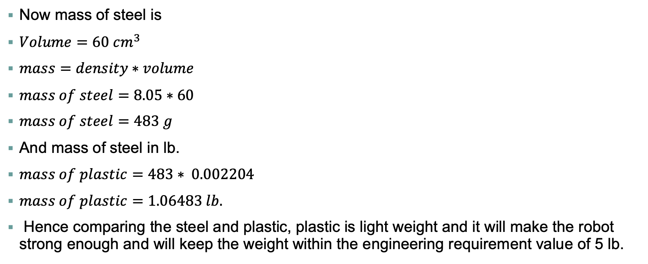
APPENDIX A – Density and Weight
Now mass of steel is
$Volume=60 cm^{3}$
$mass=density∗volume$
$mass of steel=8.05∗60$
$mass of steel=483 g$
And mass of steel in lb.
$mass of plastic=483∗ 0.002204$
$mass of plastic=1.06483 lb.$
Hence comparing the steel and plastic, plastic is light weight and it will make the robot strong enough and will keep the weight within the engineering requirement value of 5 lb.

